Slide 1


Up and Away: A Visually-Controlled Easy-to-Deploy Wireless UAV Cyber-Physical Testbed
Ahmed Saeed†, Azin Neishaboori‡, Amr Mohamed†, and Khaled A. Harras‡
College of Engineering, Qatar University
School of Computer Science, Carnegie Mellon University Qatar

Slide 2
Outline
Introduction
Related Work and Problem Formulation
Up and Away Testbed
Case Study: Target Coverage and Surveillance
Summary

Slide 3
Introduction
Cyber Physical Systems (CPS) present the evolution of computing by bridging the gap between computer science research and its interaction with the real world
CPS research is supported by development in many fields of research including embedded systems, computer vision, control, and communication
Demonstrating complete and functional systems is an expensive and complicated process as it requires demonstrating both the "physical" and the "cyber" components
Up and Away is a UAV-based testbed that enables a low-cost, easy to use and deploy "physical" component that can bring to life "cyber" simulations

Slide 4
Introduction (Cont'd)
Up and Away main contributions
Providing a complete and generic wireless testbed that allows for the detection and recognition of real objects
Detected objects are treated as input to the CPS
Using quadcopters to carry out CPS specific tasks, depending on the application superimposed on the system
Providing a vision-based localization solution that uses color tags to identify different objects in varying light intensity environments

Slide 5
Outline
Introduction
Related Work and Problem Formulation
UAV-Based Testbeds
Cyber-Physical System Testbeds
Problem Formulation
Up and Away Testbed
Case Study: Target Coverage and Surveillance
Summary

Slide 6
UAV-Based Testbeds
Most UAV developed testbeds focuses on demonstrating sophisticated control and coordination algorithms specific to UAVs thus they rely on expensive hardware
The GRASP testbed uses off-the-shelf high-end Ascending Technologies Hummingbird quadcopters ($4500) to demonstrate multirobot control algorithms
The ETH Flying Machine Arena uses modified Hummingbird quadcopters to demonstrate several acrobatic and athletics control maneuvers
Most work on UAV-based tesbteds is not design with general purpose experimentation in mind

Slide 7
Cyber Physical Systems Testbeds
CPS testbeds rely on Unmanned Ground Vehicle (UGV) as affordable solutions to allow CPS researchers to perform physical experiments
Pharos presented a networked system of autonomously mobile devices and demonstrated push-button repeatability, or the ability to easily recreate the same experiment multiple times
UPBOT which aims at testing security threats and defenses against cyber-physical systems for educational purposes
UGVs typically have limited deployment options due to the ground surface nature that’s required for UGVs to move on

Slide 8
Problem Formulation
Design a framework that enables low-cost, easy to deploy experiments for various CPS applications
Up and Away was created with the following goals in mind
Bridging the multidisciplinary nature of CPS experiments
Support of large scale experiments
Seamless control of the UAVs

Slide 9
Outline
Introduction
Related Work and Problem Formulation
Up and Away Testbed
Case Study: Target Coverage and Surveillance
Summary

Slide 10
Up and Away Testbed Architecture
UAV Node Modules that are AR Drone 2.0 specific allow UAVs to communicate with each other and process sensory information to act accordingly
Central Node Models monitors the behavior of all UAVs and handles processing intensive operation that UAVs off-load to it

Slide 11
Up and Away Testbed AR Drone 2.0 (UAV of Choice)
Quadrotor that is electrically powered equipped with various sensors
Two cameras: a front 720p camera with a 93◦ lens and a vertical QVGA camera with a 64◦ lens
Equipped with an onboard ARM Cortex A8 processor with 1 Gbit RAM that runs a Linux 2.6.32 Busybox
Altitude sensor, accelerometer, and gyroscope
Drones are controlled by an external computer through WiFi, and are The onboard computing machine is responsible for collecting
AR Drones are relatively cheap($300), easy to program and comes with a firmware that provides assisted maneuvers that facilitates motion control tasks such as hovering

Slide 12
Up and Away Testbed Localization
Earlier work in UAVs control relies on very expensive Motion Capturing Systems for tracking UAVs (>$10,000)
We chose performing localization in 2D using a single master camera
The master camera is mounted at a high point in the centre of the area of interest to track drones and other objects
UAVs and objects are identified by tagging each with a unique color tag
We rely on the drone’s altitude sensor to obtain input on the third dimension

Slide 13
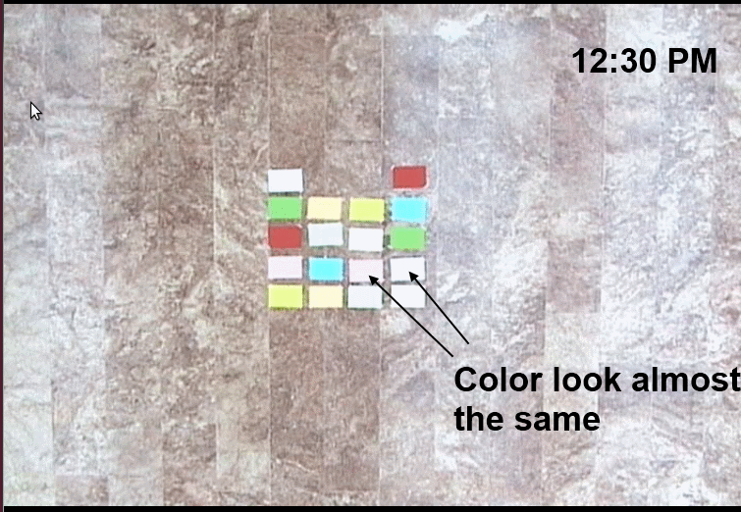
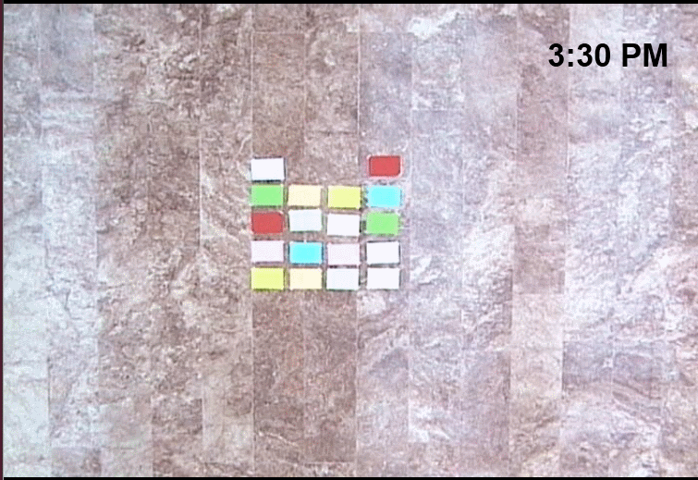
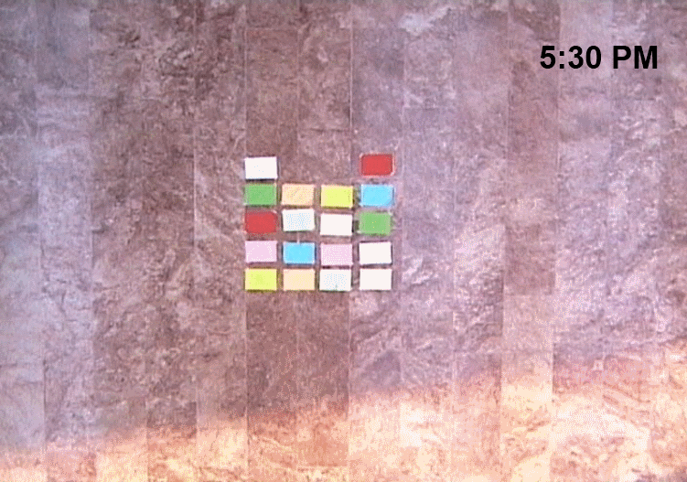
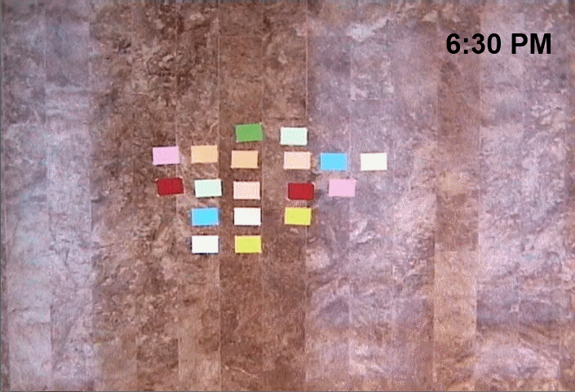
Up and Away Testbed Localization – changing light intensity conditions
Shots taken at different times of day of the same set of colored papers
Challenge is consistently detecting the color throughout an experiment given that some colors will look completely different as time goes by

Slide 14
Up and Away Testbed Localization – changing light intensity conditions
We performed several experiments and filtered the colors using RGB filters and HSV filters
RGB filters performed better than HSV filters and some colors seemed to lie within the same filtering range no matter of light intensity
Color | 12:30 - 3:00 PM | 3:00 - 4:30 PM | 4:30 - 5:00 PM
Red | 0% | 0% | 0.3%
Yellow | 0% | 0% | 0.2%
Green | 0% | 0% | 0%
Pink | 9.5% | 37.8% | 10.14%
Blue | 0% | 0% | 0%
White | 0% | 6.8% | 48.3%
Percentages of color misdetection at different times of day

Slide 15
Up and Away Testbed UAV Control
Quadcopters can move in any direction with any orientation which requires accurate settings of the yaw, roll, and pitch angular speeds
Cheap hardware doesn’t allow such accurate control
To move the drones, we first move them on the x-axis, then move them on the y-axis, then rotate towards the required angle

Slide 16
Up and Away Testbed UAV Control (Cont’d)
Motion along the axes requires leaving tolerance in the required final destination
Inertia prevents 100% placement and might lead to infinite loop trying to perfectly position the drone
White moving on a certain axis, drifts in motion on the other axis is detected and actuated

Slide 17
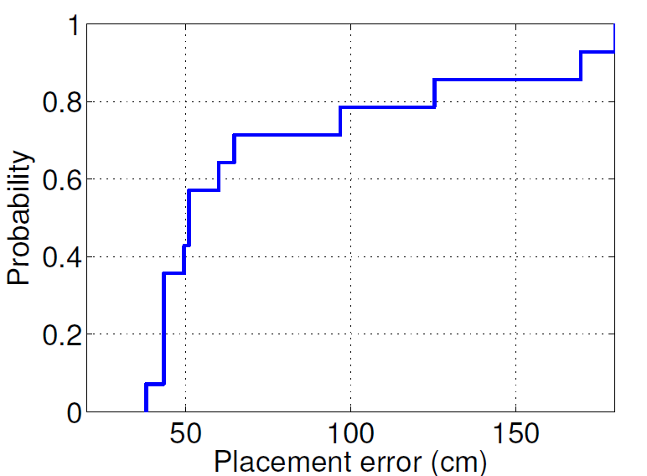
Up and Away Testbed UAV Control (Cont’d)
CDF of placement error
Generated by placing the drone arbitrarily and then moving it to a certain location over 14 times
Inaccuracies could lead to an overall placement error with a median value of approximately 50cm in a 10m x 10m area

Slide 18
Up and Away Testbed CPS Optimization
Responsible for updating the objective (i.e. location and orientation) of the drone after obtaining updates on the state of the drone and the environment from the drones’ sensors and the master camera
Up and Away provides an API that allows for the integration of simulations to facilitate the rapid deployment and testing of “cyber” projects (i.e. surveillance algorithms)

Slide 19
Up and Away Testbed Control and Coordination Networks
Separate the communication between the UAVs and the communication between each UAV and the central node into two different networks
Communication between UAVs can be established in an unreliable fashion, communication between the UAVs and the central nodes should be using an infrastructure that is connected to the UAVs at all times
AR Drone provides an SDK for monitoring and controlling the UAVs that requires continuous communication between the UAVs and a central node
Communication with the central node is made by connecting all drones to a central access point through their built in WiFi cards
We compiled a drive for WiFi dongle that is used later as the interface for the ad-hoc network between the drones

Slide 20
Outline
Introduction
Related Work and Problem Formulation
Up and Away Testbed
Case Study: Target Coverage and Surveillance
Experiment Description and Setup
Case Study Scenarios
Limitations
Summary

Slide 21
Case Study: Target Coverage and Surveillance Experiment Description and Description
We experiment with several algorithms that aim at finding the minimum number of cameras to cover a high fraction of a set of targets as a clustering problem
All required computations were offloaded to the central node because the Target Coverage System doesn’t require any processing to be made on the drones
We just used our MATAB simulation code as is to integrate with UnA
Setup:
Axis 213 PTZ Network Camera as the master camera.
The master camera is connected through ethernet to the Central Node Laptop
Two Parrot AR Drones 2.0 as the UAVs

Slide 22
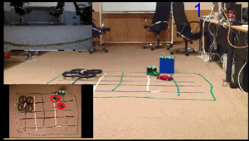
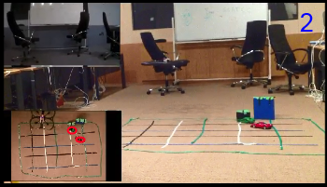
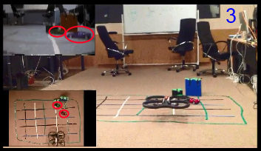
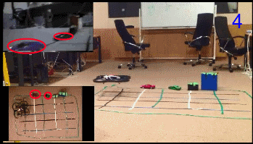
Case Study: Target Coverage and Surveillance Experimental Scenario 1
A Single Drone Chasing Two Mobile Targets

Slide 23
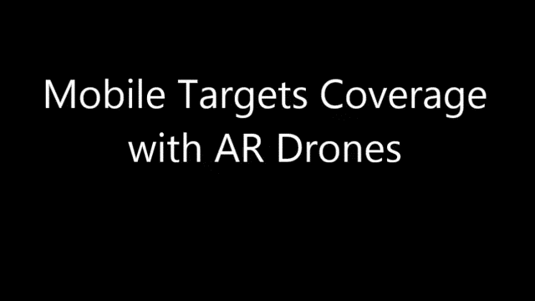
Case Study: Target Coverage and Surveillance Experimental Scenario 1

Slide 24
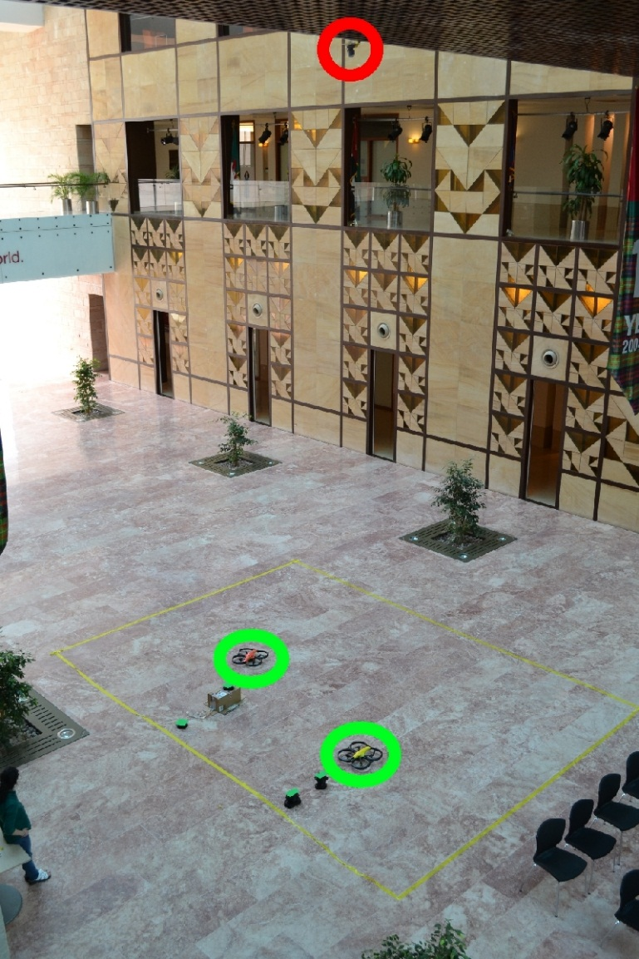
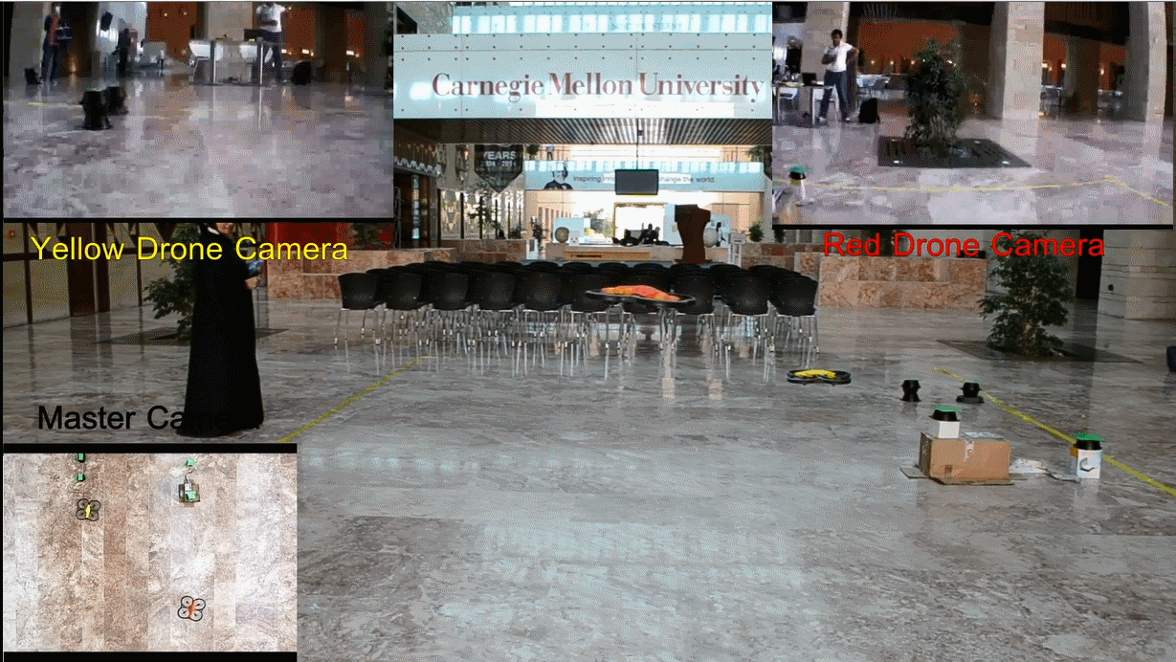
Case Study: Target Coverage and Surveillance Experimental Scenario 2
Two drones moving to cover stationary targets

Slide 25
Case Study: Target Coverage and Surveillance Limitations
AR Drone has exhibits repeated failures in the built in sensors (e.g. compass and altitude sensors)
causes serious problems in controlling the rotation and altitude of the drone
AR Drones have recurring errors in assisted manoeuvres provided by the its firmware (e.g. spontaneous rotations, unstable hovering, and sudden changes in drone altitude)
Placement errors can be as large as 150 cm as shown in the CDF figure which affect the repeatability of the experiments

Slide 26
Summary and Future Work
Up and Away is a low-cost, easy to deploy testbed for cyber-physical experiments that uses UAVs to perform various tasks
Up and Away allows for seamless integration of simulation code to bring it to life for realistic testing of proposed algorithms
Up and Away has some limitations which can be addressed by extending the control algorithm and adding more sensors to the drone
We plan to extend the testbed by connecting a Raspberry Pi to act as the drone’s “brain” and add more sensors to it, we also plan to deploy click modular router on the drones to allow for more interesting networking experiments

